Slide 1
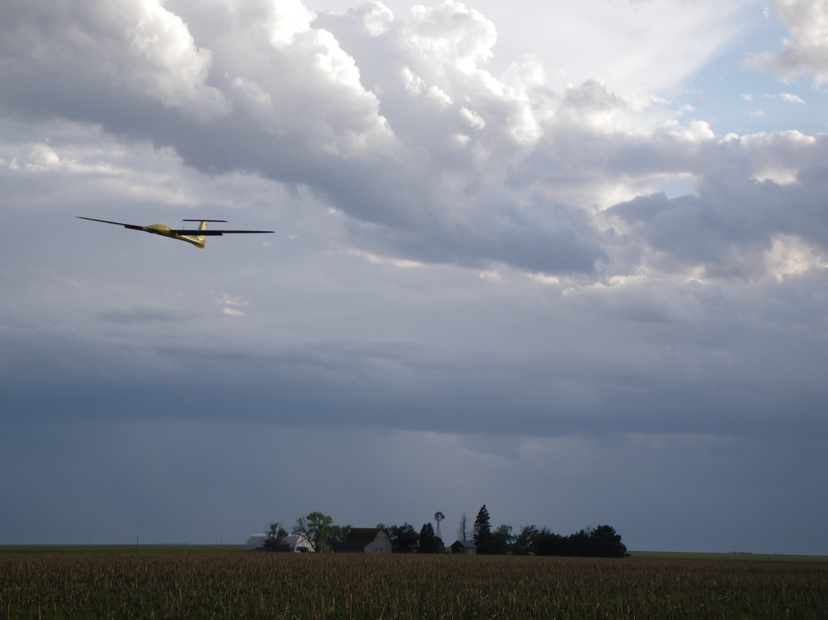
Chapter 8
State Estimation

Slide 2
Architecture

Slide 3
Why estimate states?
State information needed to control aircraft
We measure many things
accelerations, angular rates, pressure altitude, dynamic pressure (airspeed), magnetic heading (sometimes), GPS position
Don’t have direct measurements of everything we need
Notes:
\begin{table}
\centering
\begin{tabular}{|c|l|}
\hline
State & Measured directly or estimated? \\
\hline \hline
$p_n$ & Measured (GPS) and smoothed \\ \hline
$p_e$ & Measured (GPS) and smoothed \\ \hline
$p_d$ & Measured (absolute pressure, GPS) \\ \hline
$u$ & Estimated with EKF \\ \hline
$v$ & Estimated with EKF \\ \hline
$w$ & Estimated with EKF \\ \hline
$\phi$ & Estimated with EKF \\ \hline
$\theta$ & Estimated with EKF \\ \hline
$\psi$ & Estimated with EKF \\ \hline
$p$ & Measured (rate gyro) \\ \hline
$q$ & Measured (rate gyro) \\ \hline
$r$ & Measured (rate gyro) \\
\hline
\end{tabular}
\end{table} \index{State Variables}

Slide 4
Benchmark Maneuver

Slide 5
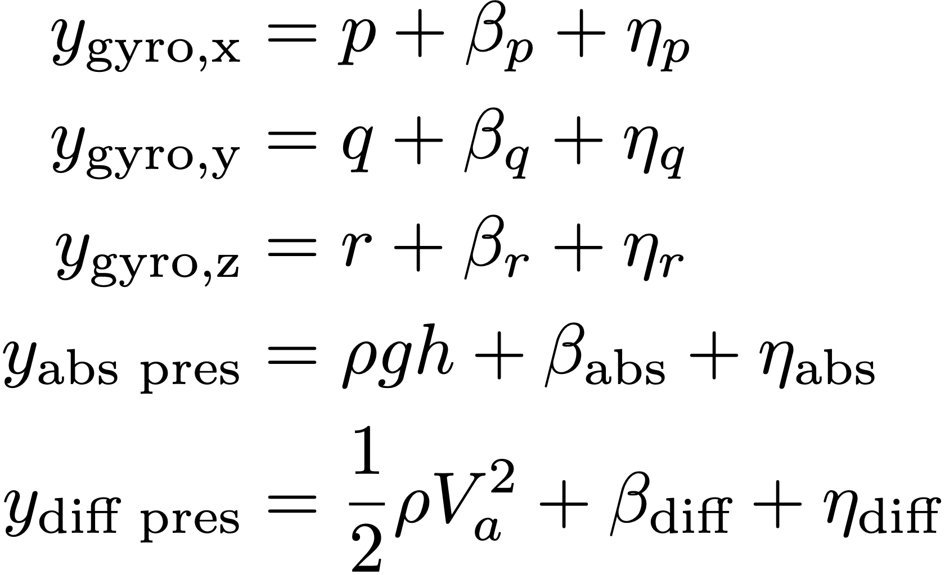
Inverting Sensor Measurement Model
Several states can be estimated by inverting sensor measurement model
Angular rates, altitude, airspeed
LPF denotes low pass filter
Mathematical Model
State Estimate
Notes:
\hat{p} &= \mathit{LPF}(y_{\text{gyro,x}}) \\
\hat{q} &= \mathit{LPF}(y_{\text{gyro,y}}) \\
\hat{r} &= \mathit{LPF}(y_{\text{gyro,z}}) \\
\hat{h} &= \frac{\mathit{LPF}(y_{\text{static pres}})}{\rho g} \\
\hat{V}_a &= \sqrt{\frac{2}{\rho}\mathit{LPF}(y_{\text{diff pres}})}
y_{\text{gyro,x}} &= p + \beta_p + \eta_p \\
y_{\text{gyro,y}} &= q + \beta_q + \eta_q \\
y_{\text{gyro,z}} &= r + \beta_r + \eta_r \\
y_{\text{abs pres}} &= \rho g h + \beta_{\text{abs}} + \eta_{\text{abs}} \\
y_{\text{diff pres}} &= \frac{1}{2}\rho V_a^2 + \beta_{\text{diff}} + \eta_{\text{diff}}

Slide 8
Inverting Sensor Measurement Model
Notes:
\noindent Assuming steady, level flight (no acceleration), we can also invert accelerometer measurements to determine pitch and roll. Accelerometer outputs are
\begin{align*}
y_{\text{accel,x}} &= \dot{u} + qw - rv + g\sin\theta +
\eta_{\text{accel,x}} \\
y_{\text{accel,y}} &= \dot{v} + ru - pw
-g\cos\theta\sin\phi +
\eta_{\text{accel,y}} \\
y_{\text{accel,z}} &= \dot{w} + pv - qu -
g\cos\theta\cos\phi + \eta_{\text{accel,z}}
\end{align*}
In unaccelerated flight, $\dot{u}=\dot{v}=\dot{w}=p=q=r=0$, and
\begin{align*}
\mathit{LPF}(y_{\text{accel,x}}) &= g\sin\theta \\
\mathit{LPF}(y_{\text{accel,y}}) &= -g\cos\theta\sin\phi\\
\mathit{LPF}(y_{\text{accel,z}}) &= -g\cos\theta\cos\phi
\end{align*}
Solving for $\phi$ and $\theta$:
\begin{align*}
\hat{\phi}_{\text{accel}} &= \tan^{-1}\left(
\frac{\mathit{LPF}(y_{\text{accel,y}})} {\mathit{LPF}(y_{\text{accel,z}})} \right) \\
\hat{\theta}_{\text{accel}} &= \sin^{-1}\left( \frac{\mathit{LPF}(y_{\text{accel,x}})}{g} \right)
\end{align*}

Slide 10
Inverting Sensor Measurement Model
Notes:
\begin{itemize}
\item Can also invert sensor models for GPS signals:
\begin{align*}
\hat{p}_n &= \mathit{LPF}(y_{\text{GPS,n}})
\\
\hat{p}_e &= \mathit{LPF}(y_{\text{GPS,e}}) \\
\hat{\chi} &= \mathit{LPF}(y_{\text{GPS},\chi}) \\
\hat{V}_g &= \mathit{LPF}(y_{\text{GPS},V_g})
\end{align*}
\item Update rate too slow (~1 Hz)
\item Need to fill in samples between measurement updates
\end{itemize}

Slide 12
Dynamic Observer Theory
Notes:
Given linear time-invariant model
\begin{align*}
\dot{x} &= Ax + Bu \\
y&= Cx.
\end{align*}
A continuous-time observer for this system is given by
\begin{align*}
\dot{\hat{x}} &=
\underbrace{A\hat{x} + Bu}
\qquad + \qquad \underbrace{L\left( y - C\hat{x} \right)},
\label{eq:est-continuous-observer} \\
& \text{copy of the model} ~~~~ \text{correction due to sensor
reading}
\notag
\end{align*}
where $\hat{x}$ is the estimated value of $x$. Defining the observation error as $\tilde{x} =
x-\hat{x}$
\[
\dot{\tilde{x}} = (A-LC)\tilde{x}.
\]
Therefore, observation error $\to 0$ if $\text{eig}(A-LC)$ in LHP.

Slide 13
Dynamic Observer Theory, cont.
Notes:
For sampled data systems we use a predictor-corrector structure:
\underline{Between Measurements (predictor):}
\[
\dot{\hat{x}} = A\hat{x} + Bu,
\]
\underline{At a Measurements (corrector):}
\[
\hat{x}^+ = \hat{x}^- + L(y(t_n) - C\hat{x}^-),
\]
where $t_n$ is the instant in time that the measurement is received
and $\hat{x}^-$ is the state estimate produced at time $t_n$.
For nonlinear systems:
\underline{Between Measurements (predictor):}
\[
\dot{\hat{x}} = f(\hat{x}, u)
\]
\underline{At a Measurements (corrector):}
\[
\hat{x}^+ = \hat{x}^- + L(y(t_n) - h(\hat{x}^-)).
\]

Slide 14
Dynamic Observer Theory, cont.

Slide 15
Kalman Filter
Notes:
The Kalman filter follows this same process, but also attempts to estimate the quality of the estimate at each time step by propagating an error covariance matrix.

Slide 16
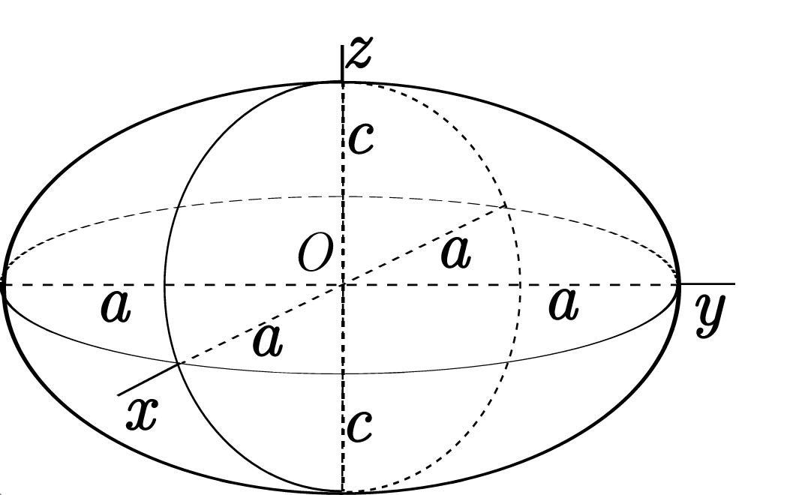
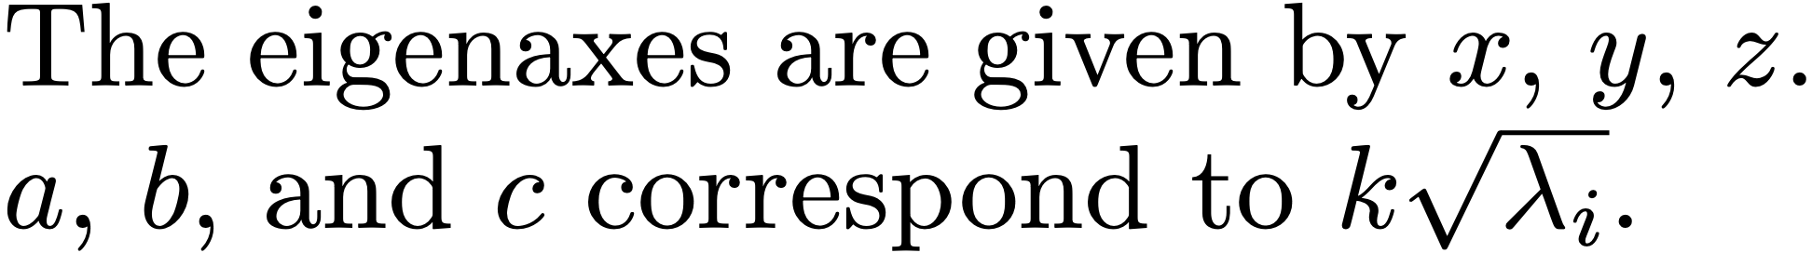
Quadratic Forms
Notes:
Recall that for a positive definite matrix $P=P^{\top}>0$, the set
\[
\mathcal{E}(k) = \left\{y\in\mathbb{R}^n: y^{\top}P^{-1}y=k^2 \right\}
\]
is an ellipsoid whose axes are aligned with the eigenvectors of $P$, with stretching along each axis given by $k\sqrt{\lambda_i}$ where $\lambda_i$ is an eigenvalue of $P$.
--
(From wikipedia)
--
The eigenaxes are given by $x$, $y$, $z$.
$a$, $b$, and $c$ correspond to $k\sqrt{\lambda_i}$.

Slide 17
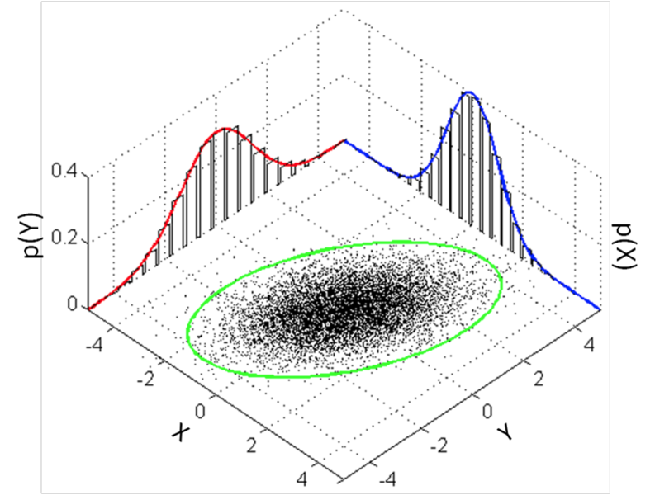
Multivariate Gaussian
Notes:
The multivariate Gaussian distribution is given by
\[
\mathcal{N}(\mu,P) = \frac{1}{(2\pi)^{k/2}\|P\|^{1/2}}\text{exp}\left(-\frac{1}{2}(x-\mu)^{\top}P^{-1}(x-\mu)\right),
\]
where $\mu$ is the mean and $P$ is the covariance matrix. The $k-\sigma$ ellipsoid is defined as
\[
\mathcal{E}(k\sigma) = \left\{x\in\mathbb{R}^k: (x-\mu)^{\top}P^{-1}(x-\mu) = k\sigma \right\}
\]
where $\sigma$ is the generalized standard deviation.

Slide 18
Kalman Filter
Notes:
Assume continuous linear system dynamics, with discrete measurement update
\begin{align*}
\dot{x} &= Ax + Bu + \xi \\
y[n] &= Cx[n] + \eta[n],
\end{align*}
where
$\xi\sim\mathcal{N}(0,Q)$ is the process noise,
$\nu\sim\mathcal{N}(0,R)$ is the measurement noise.
The measurement covariance $R$ is usually obtained from sensor calibration. The process covariance $Q$ represents all other uncertainties in the system and is the tuning parameter for the Kalman filter.

Slide 19
Kalman Filter Derivation
Notes:
The continuous-discrete Kalman filter has the form
\begin{align*}
\dot{\hat{x}} &= A\hat{x} + Bu \qquad \qquad \qquad \qquad \text{(Prediction)} \\
\hat{x}^+ &= \hat{x}^- + L(y(t_n) - C\hat{x}^-). \qquad \text{(Correction)}
\end{align*}
%
Define the estimation error
\[
\tilde{x} = x-\hat{x},
\]
and the covariance of the estimation error
\[
P(t) = E\{ \tilde{x}(t) \tilde{x}(t)^{\top} \},
\]
where $P=P^\top \geq 0$.
\vspace{0.5cm}
\par\noindent{\bf Estimation Objective:} Chose the estimation gain $L$ s.t.
\begin{itemize}
\item $E\{\tilde{x}(t)\}=0$ (unbiased),
\item $\text{trace}(P) = \sum \lambda_i$ is minimized.
\end{itemize}

Slide 20
Kalman Filter Derivation
Notes:
\par\noindent{\bf Between Measurements (prediction}:}
Differentiate $\tilde{x}$
\begin{align*}
\dot{\tilde{x}} &= \dot{x} - \dot{\hat{x}} \\
&= Ax + Bu + \xi - A\hat{x} - Bu \\
&= A\tilde{x} + \xi.
\end{align*}
Solve for $\tilde{x}(t)$:
\[
\tilde{x}(t) = e^{At}\tilde{x}_0 + \int_0^t
e^{A(t-\tau)}\xi(\tau)\,d\tau.
\]

Slide 21
Kalman Filter Derivation
Notes:
\par\noindent{\bf Between Measurements (prediction):}
Compute the evolution of the error covariance $P$:
\begin{align*}
\dot{P} &= \frac{d}{dt} E\{\tilde{x}\tilde{x}^{\top}\} \\
&= E\{ \dot{\tilde{x}}\tilde{x}^{\top} + \tilde{x}\dot{\tilde{x}}^{\top} \} \\
&= E\left\{ A\tilde{x}\tilde{x}^{\top} + \xi\tilde{x}^{\top} +
\tilde{x}\tilde{x}^{\top}A^{\top} + \tilde{x}\xi^{\top} \right\} \\
&= AP + PA^{\top} + E\{\xi\tilde{x}^{\top}\} + E\{\tilde{x}\xi^{\top}\},
\end{align*}
Where
\begin{align*}
E\{\tilde{x}\xi^{\top}\} &=
E\{
e^{At}\tilde{x}_0 \xi^{\top}(t)
+ \int_0^t e^{A(t-\tau)}\xi(\tau)\xi^{\top}(\tau)\,d\tau
\} \\
&= \int_0^t e^{A(t-\tau)}Q\delta(t-\tau)\,d\tau \\
&= \frac{1}{2} Q. \qquad \text{(only used half of area in delta function)}
\end{align*}
Therefore
\[
\dot{P} = AP + PA^{\top} + Q.
\]

Slide 22
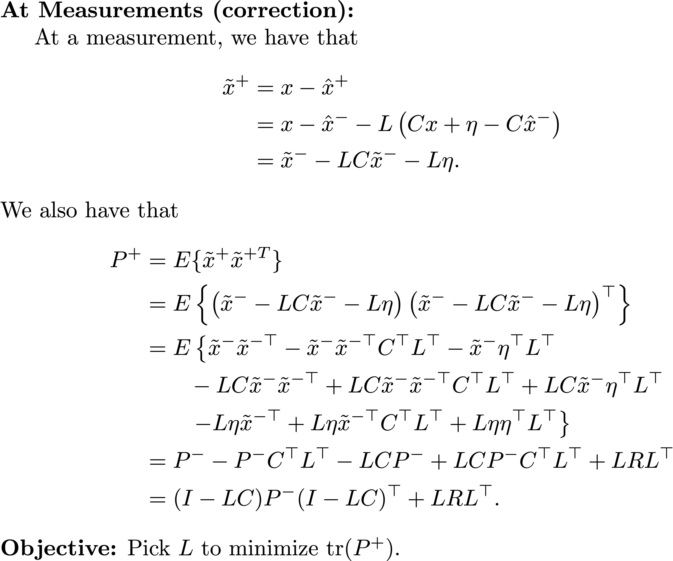
Kalman Filter Derivation
Notes:
\par\noindent{\bf At Measurements (correction):}
At a measurement, we have that
\begin{align*}
\tilde{x}^{+} &= x-\hat{x}^{+} \\
&= x-\hat{x}^{-} - L\left(Cx + \eta - C\hat{x}^{-}\right) \\
&= \tilde{x}^{-} - LC\tilde{x}^{-} - L\eta.
\end{align*}
We also have that
\begin{align*}
P^{+} &= E\{ \tilde{x}^{+}\tilde{x}^{+T} \} \\
&= E\left\{ \left( \tilde{x}^{-} - LC\tilde{x}^{-} - L\eta \right)
\left( \tilde{x}^{-} - LC\tilde{x}^{-} - L\eta \right)^{\top} \right\} \notag \\
&= E\left\{ \tilde{x}^{-}\tilde{x}^{-\top} -
\tilde{x}^{-}\tilde{x}^{-\top} C^{\top} L^{\top} - \tilde{x}^{-} \eta^{\top} L^{\top}
\right. \\
&\qquad -LC\tilde{x}^{-}\tilde{x}^{-\top} + LC
\tilde{x}^{-}\tilde{x}^{-\top} C^{\top} L^{\top} + LC\tilde{x}^{-}\eta^{\top}L^{\top} \notag \\
&\qquad \left. -L\eta\tilde{x}^{-\top} + L\eta\tilde{x}^{-\top}C^{\top}L^{\top} +
L\eta\eta^{\top}L^{\top} \right\} \\
&= P^{-} - P^{-}C^{\top}L^{\top} - LCP^{-} + LCP^{-}C^{\top}L^{\top} + LRL^{\top} \\
&= (I - LC)P^{-}(I-LC)^\top + LRL^\top.
\end{align*}
\par\noindent{\bf Objective:} Pick $L$ to minimize $\text{tr}(P^+)$.

Slide 23
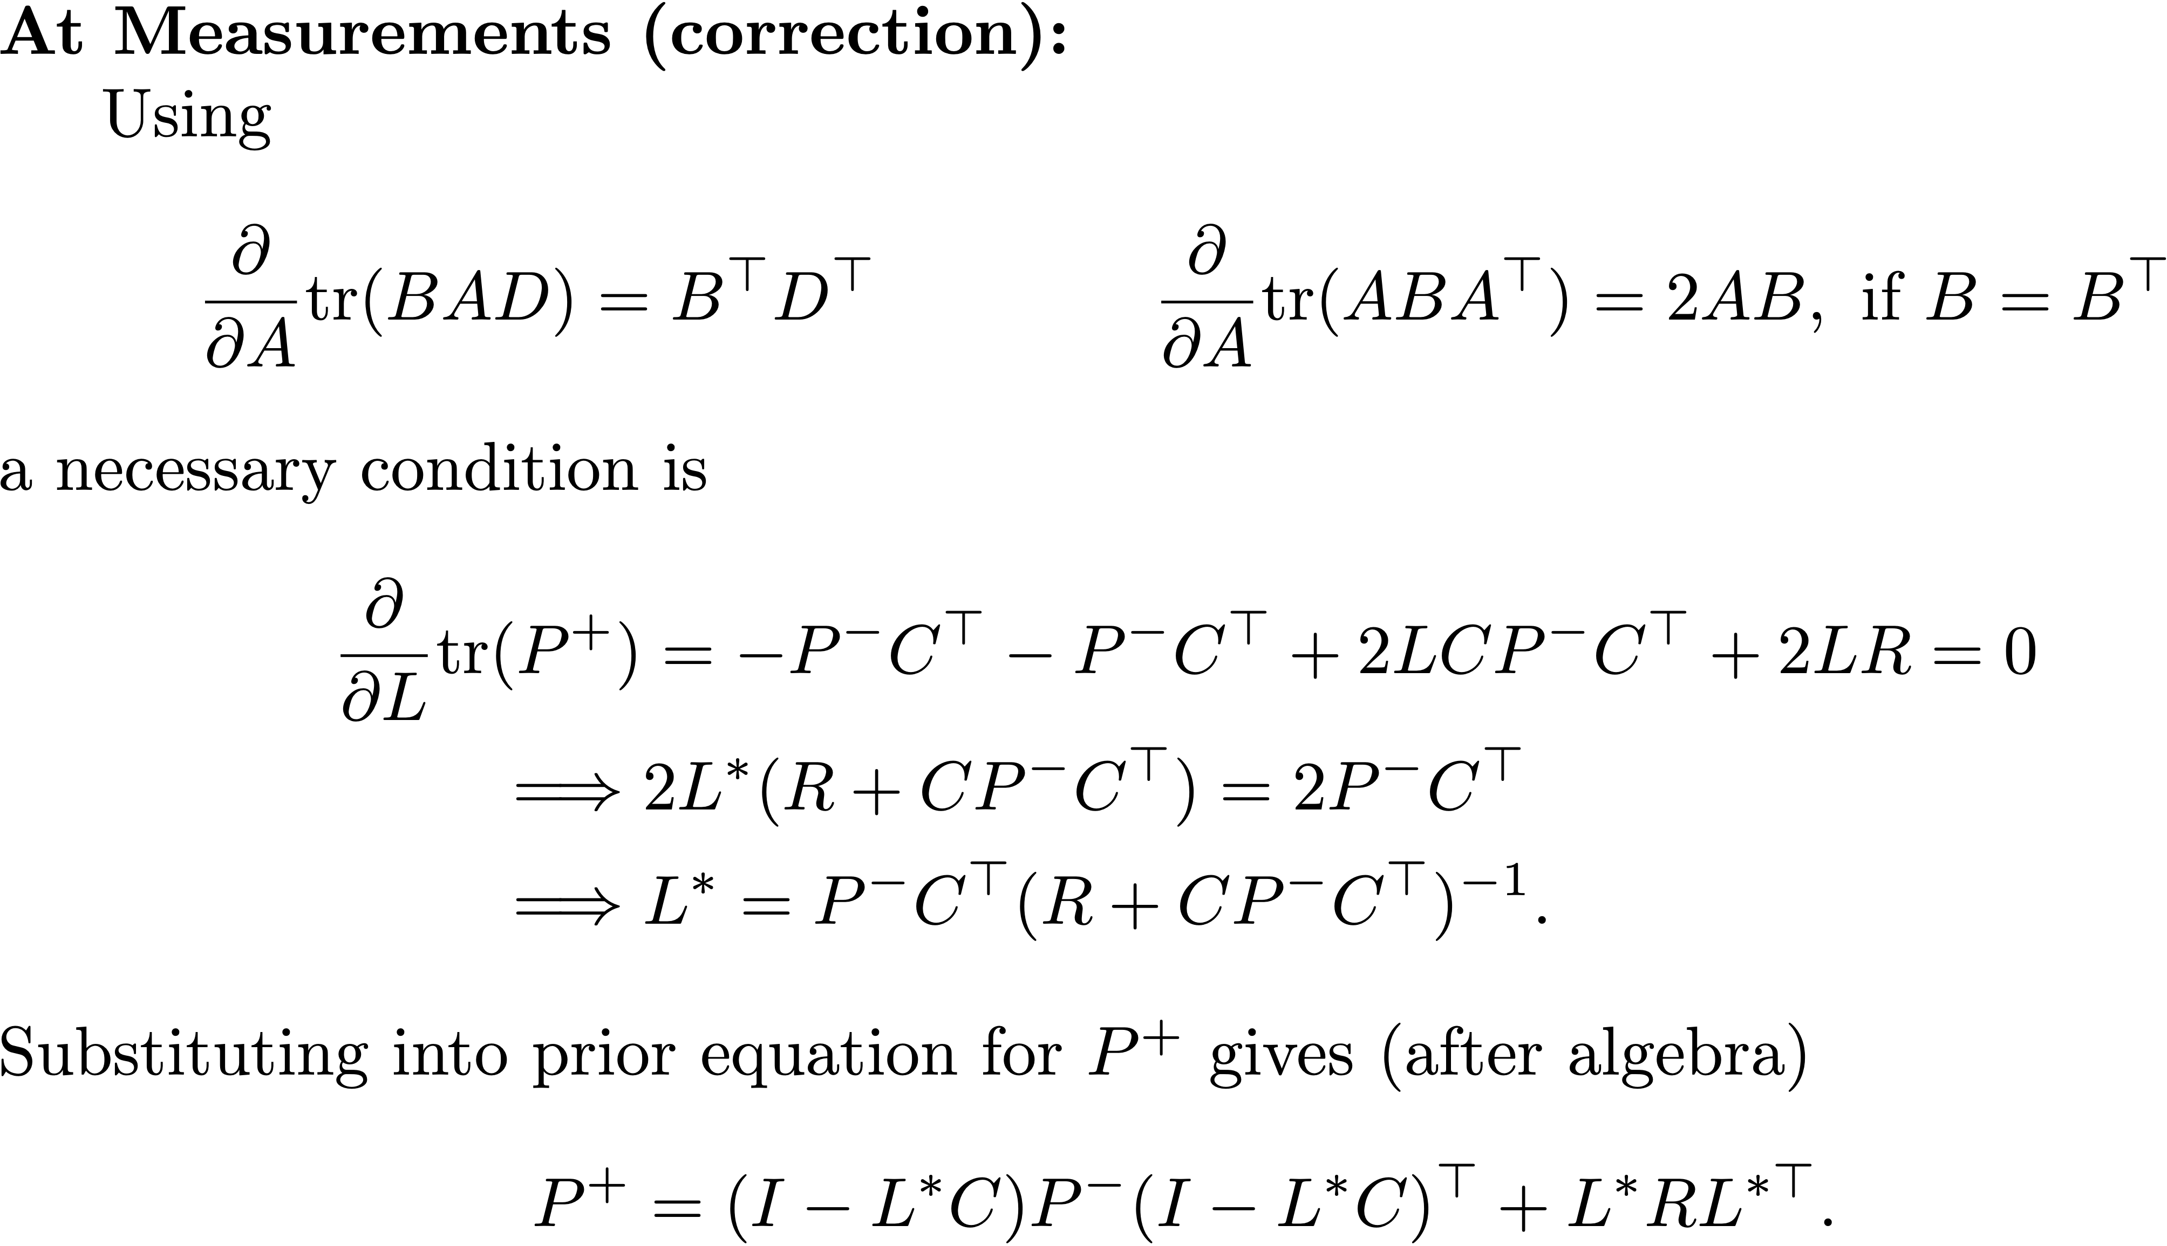
Kalman Filter Derivation
Notes:
\par\noindent{\bf At Measurements (correction):}
Using
\[
\frac{\partial}{\partial A} \text{tr}(BAD) = B^{\top} D^{\top}
\qquad \qquad
\frac{\partial}{\partial A} \text{tr}(ABA^{\top}) = 2AB, \text{~if~} B=B^{\top}
\]
a necessary condition is
\begin{align*}
\frac{\partial}{\partial L} \text{tr}(P^{+}) &= -P^{-}C^{\top} - P^{-}C^{\top}
+ 2LCP^{-}C^{\top} + 2LR = 0 \\
\implies & 2L^\ast (R+CP^{-}C^{\top})=2P^{-}C^{\top} \\
\implies & L^\ast = P^{-}C^{\top}(R+CP^{-}C^{\top})^{-1}.
\end{align*}
Substituting into prior equation for $P^+$ gives (after algebra)
\[
P^{+} = (I - L^\ast C) P^{-} (I-L^\ast C)^\top + L^\ast R L^{\ast\top}.
\]

Slide 24
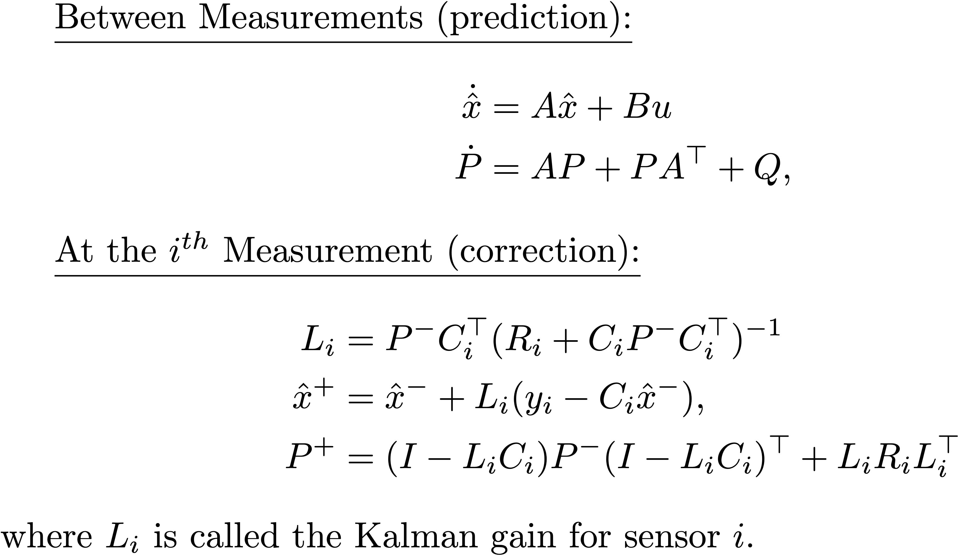
Kalman Filter Derivation
Notes:
\underline{Between Measurements (prediction):}
\begin{align*}
\dot{\hat{x}} &= A\hat{x} + Bu \\
\dot{P} &= AP + PA^{\top} + Q,
\end{align*}
\underline{At the $i^{th}$ Measurement (correction):}
\begin{align*}
L_i &= P^{-}C_i^{\top}(R_i+C_iP^{-}C_i^{\top})^{-1} \\
\hat{x}^+ &= \hat{x}^- + L_i(y_i - C_i \hat{x}^-), \\
P^{+} &= (I-L_i C_i) P^{-} (I-L_i C_i)^\top + L_i R_i L_i^{\top}
\end{align*}
where $L_i$ is called the Kalman gain for sensor $i$.

Slide 25
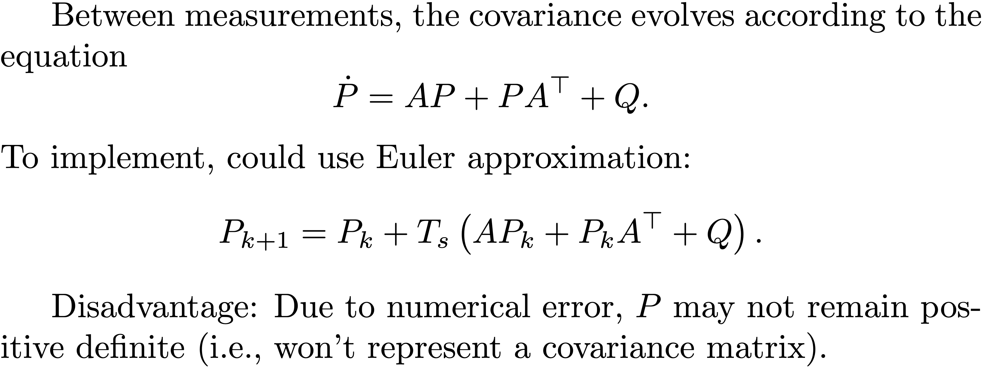
Covariance Update
Notes:
Between measurements, the covariance evolves according to the equation
\[
\dot{P} = AP + PA^\top + Q.
\]
To implement, could use Euler approximation:
\[
P_{k+1} = P_k + T_s \left(AP_k + P_kA^\top + Q\right).
\]
Disadvantage: Due to numerical error, $P$ may not remain positive definite (i.e., won't represent a covariance matrix).

Slide 26
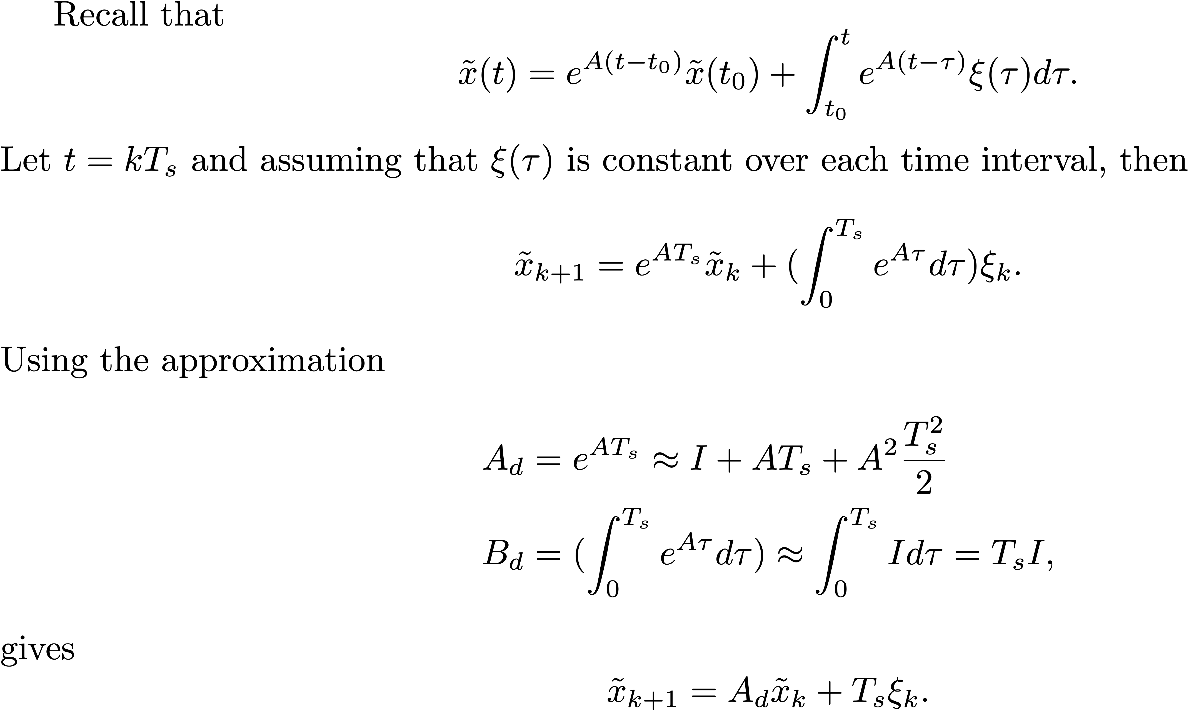
Covariance Update
Notes:
Recall that
\[
\tilde{x}(t) = e^{A(t-t_0)}\tilde{x}(t_0) + \int_{t_0}^t e^{A(t-\tau)} \xi(\tau) d\tau.
\]
Let $t=kT_s$ and assuming that $\xi(\tau)$ is constant over each time interval, then
\[
\tilde{x}_{k+1} = e^{AT_s} \tilde{x}_k + (\int_{0}^{T_s} e^{A\tau} d\tau) \xi_k.
\]
Using the approximation
\begin{align*}
A_d &= e^{AT_s} \approx I + AT_s + A^2 \frac{T_s^2}{2} \\
B_d &= (\int_{0}^{T_s} e^{A\tau} d\tau) \approx \int_0^{T_s} I d\tau = T_s I,
\end{align*}
gives
\[
\tilde{x}_{k+1} = A_d \tilde{x}_k + T_s \xi_k.
\]

Slide 27
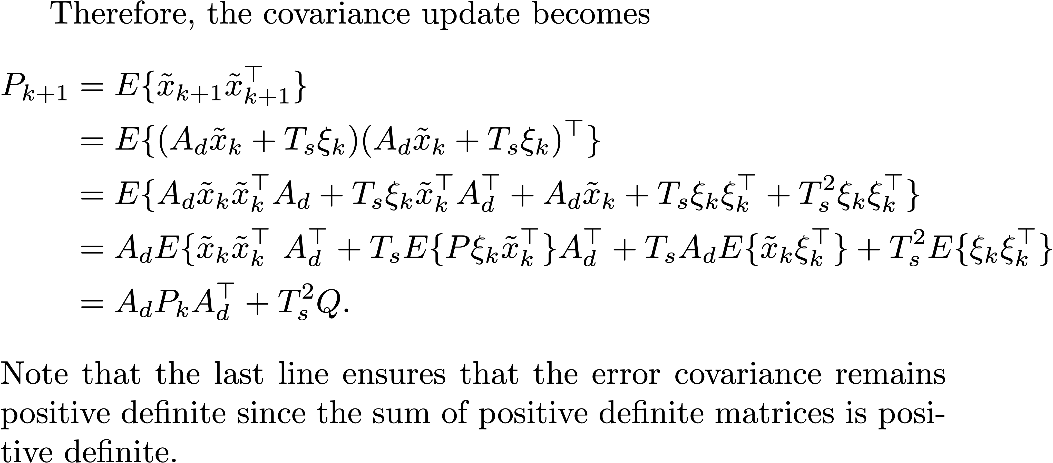
Covariance Update
Notes:
Therefore, the covariance update becomes
\begin{align*}
P_{k+1} &= E\{\tilde{x}_{k+1}\tilde{x}_{k+1}^\top\} \\
&= E\{(A_d \tilde{x}_k + T_s \xi_k)(A_d \tilde{x}_k + T_s \xi_k)^\top\} \\
&= E\{A_d \tilde{x}_k \tilde{x}_k^\top A_d + T_s \xi_k\tilde{x}_k^\top A_d^\top
+ A_d \tilde{x}_k + T_s \xi_k \xi_k^\top + T_s^2\xi_k\xi_k^\top\} \\
&= A_d E\{\tilde{x}_k \tilde{x}_k^\top\ A_d^\top + T_s E\{P\xi_k\tilde{x}_k^\top\} A_d^\top
+ T_s A_d E\{\tilde{x}_k\xi_k^\top\} + T_s^2 E\{\xi_k\xi_k^\top\} \\
&= A_d P_k A_d^\top + T_s^2 Q.
\end{align*}
Note that the last line ensures that the error covariance remains positive definite since the sum of positive definite matrices is positive definite.

Slide 28
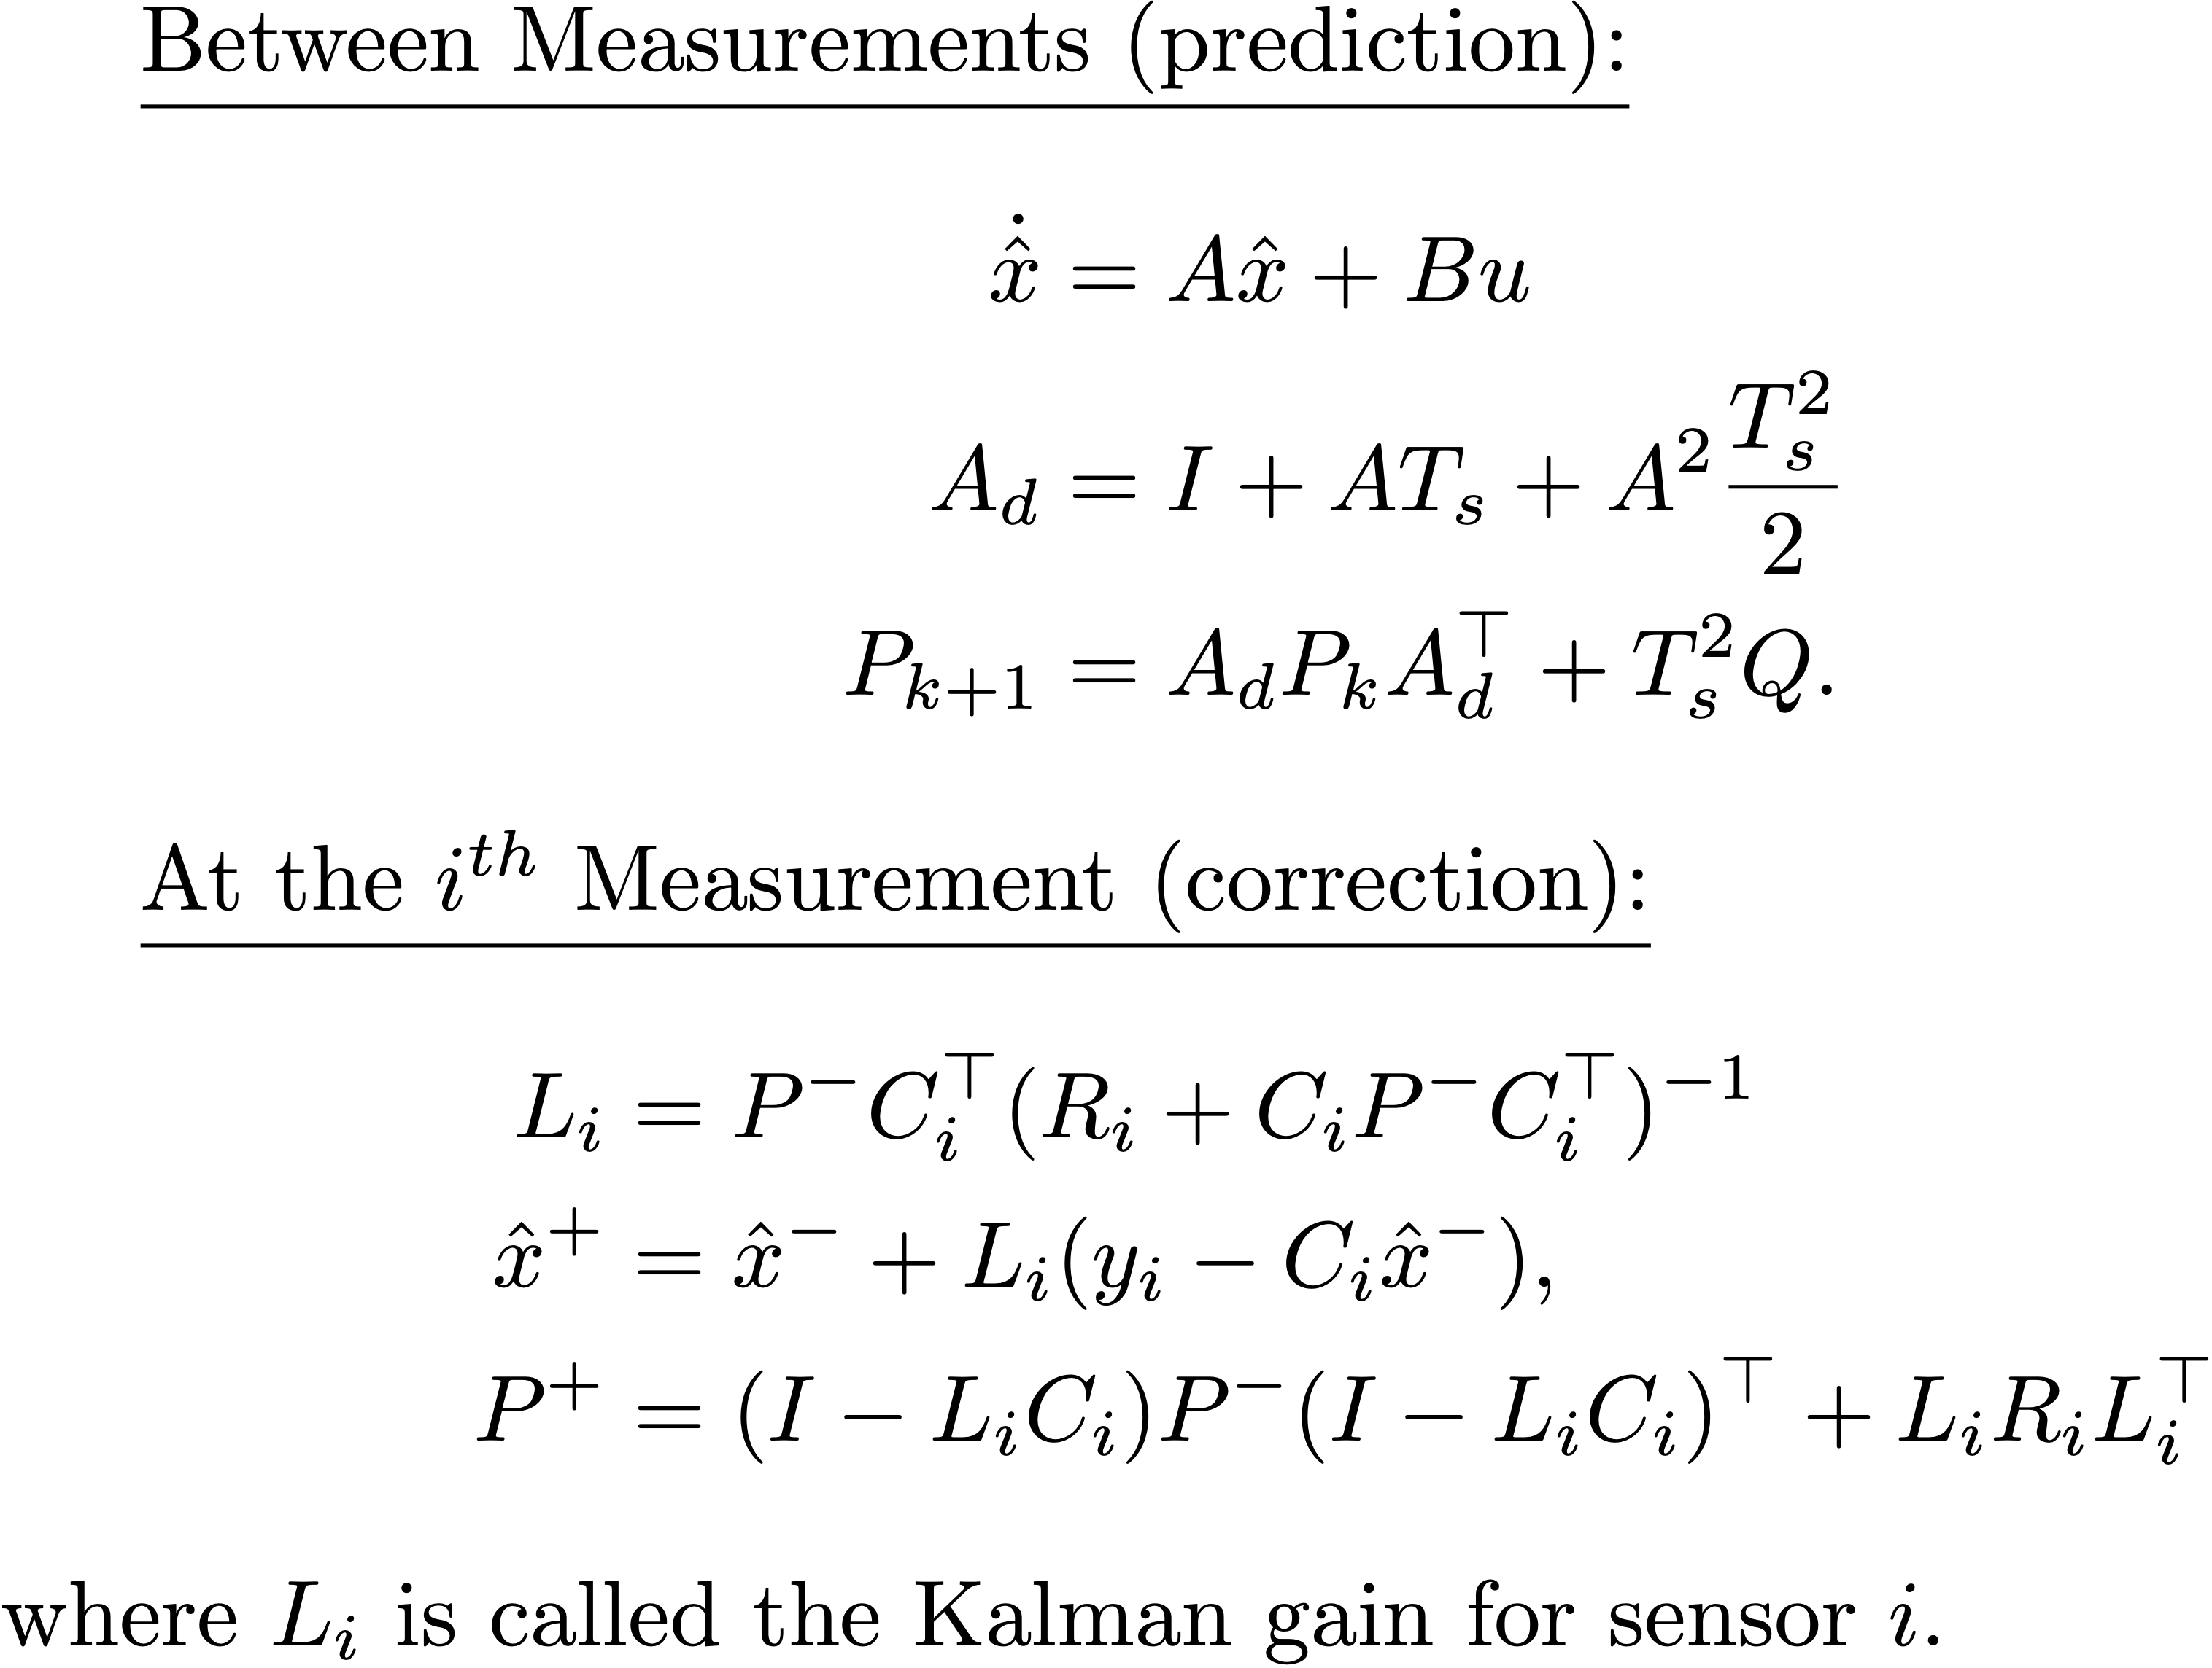
Kalman Filter Derivation
Notes:
\underline{Between Measurements (prediction):}
\begin{align*}
\dot{\hat{x}} &= A\hat{x} + Bu \\
A_d &= I + AT_s + A^2 \frac{T_s^2}{2} \\
P_{k+1} &= A_d P_k A_d^\top + T_s^2 Q.
\end{align*}
\underline{At the $i^{th}$ Measurement (correction):}
\begin{align*}
L_i &= P^{-}C_i^{\top}(R_i+C_iP^{-}C_i^{\top})^{-1} \\
\hat{x}^+ &= \hat{x}^- + L_i(y_i - C_i \hat{x}^-), \\
P^{+} &= (I-L_i C_i) P^{-} (I-L_i C_i)^\top + L_i R_i L_i^{\top}
\end{align*}
where $L_i$ is called the Kalman gain for sensor $i$.

Slide 29
Extended Kalman Filter
Notes:
Basic idea of Extended Kalman Filter:
\begin{itemize}
\item Propagate multivariate Gaussian distribution that captures probability distribution associated with belief about state
\item Mean of distribution is $\hat{x}$ --- estimated state
\item Covariance quantifies associated estimation error
\item Kalman gain minimizes covariance of estimation error given uncertainty in model and measurements
\end{itemize}
\vspace{0.25in} \noindent
System model given by:
\begin{align*}
\dot{x} &= f(x,u) + \xi \\
y_i[n] &= h_i(x[n],u[n]) + \eta_i[n],
\end{align*}
where
\begin{align*}
\xi &\sim \mathcal{N}(0,Q) \\
\eta_i &\sim \mathcal{N}(0,R_i) \\
\end{align*}

Slide 30
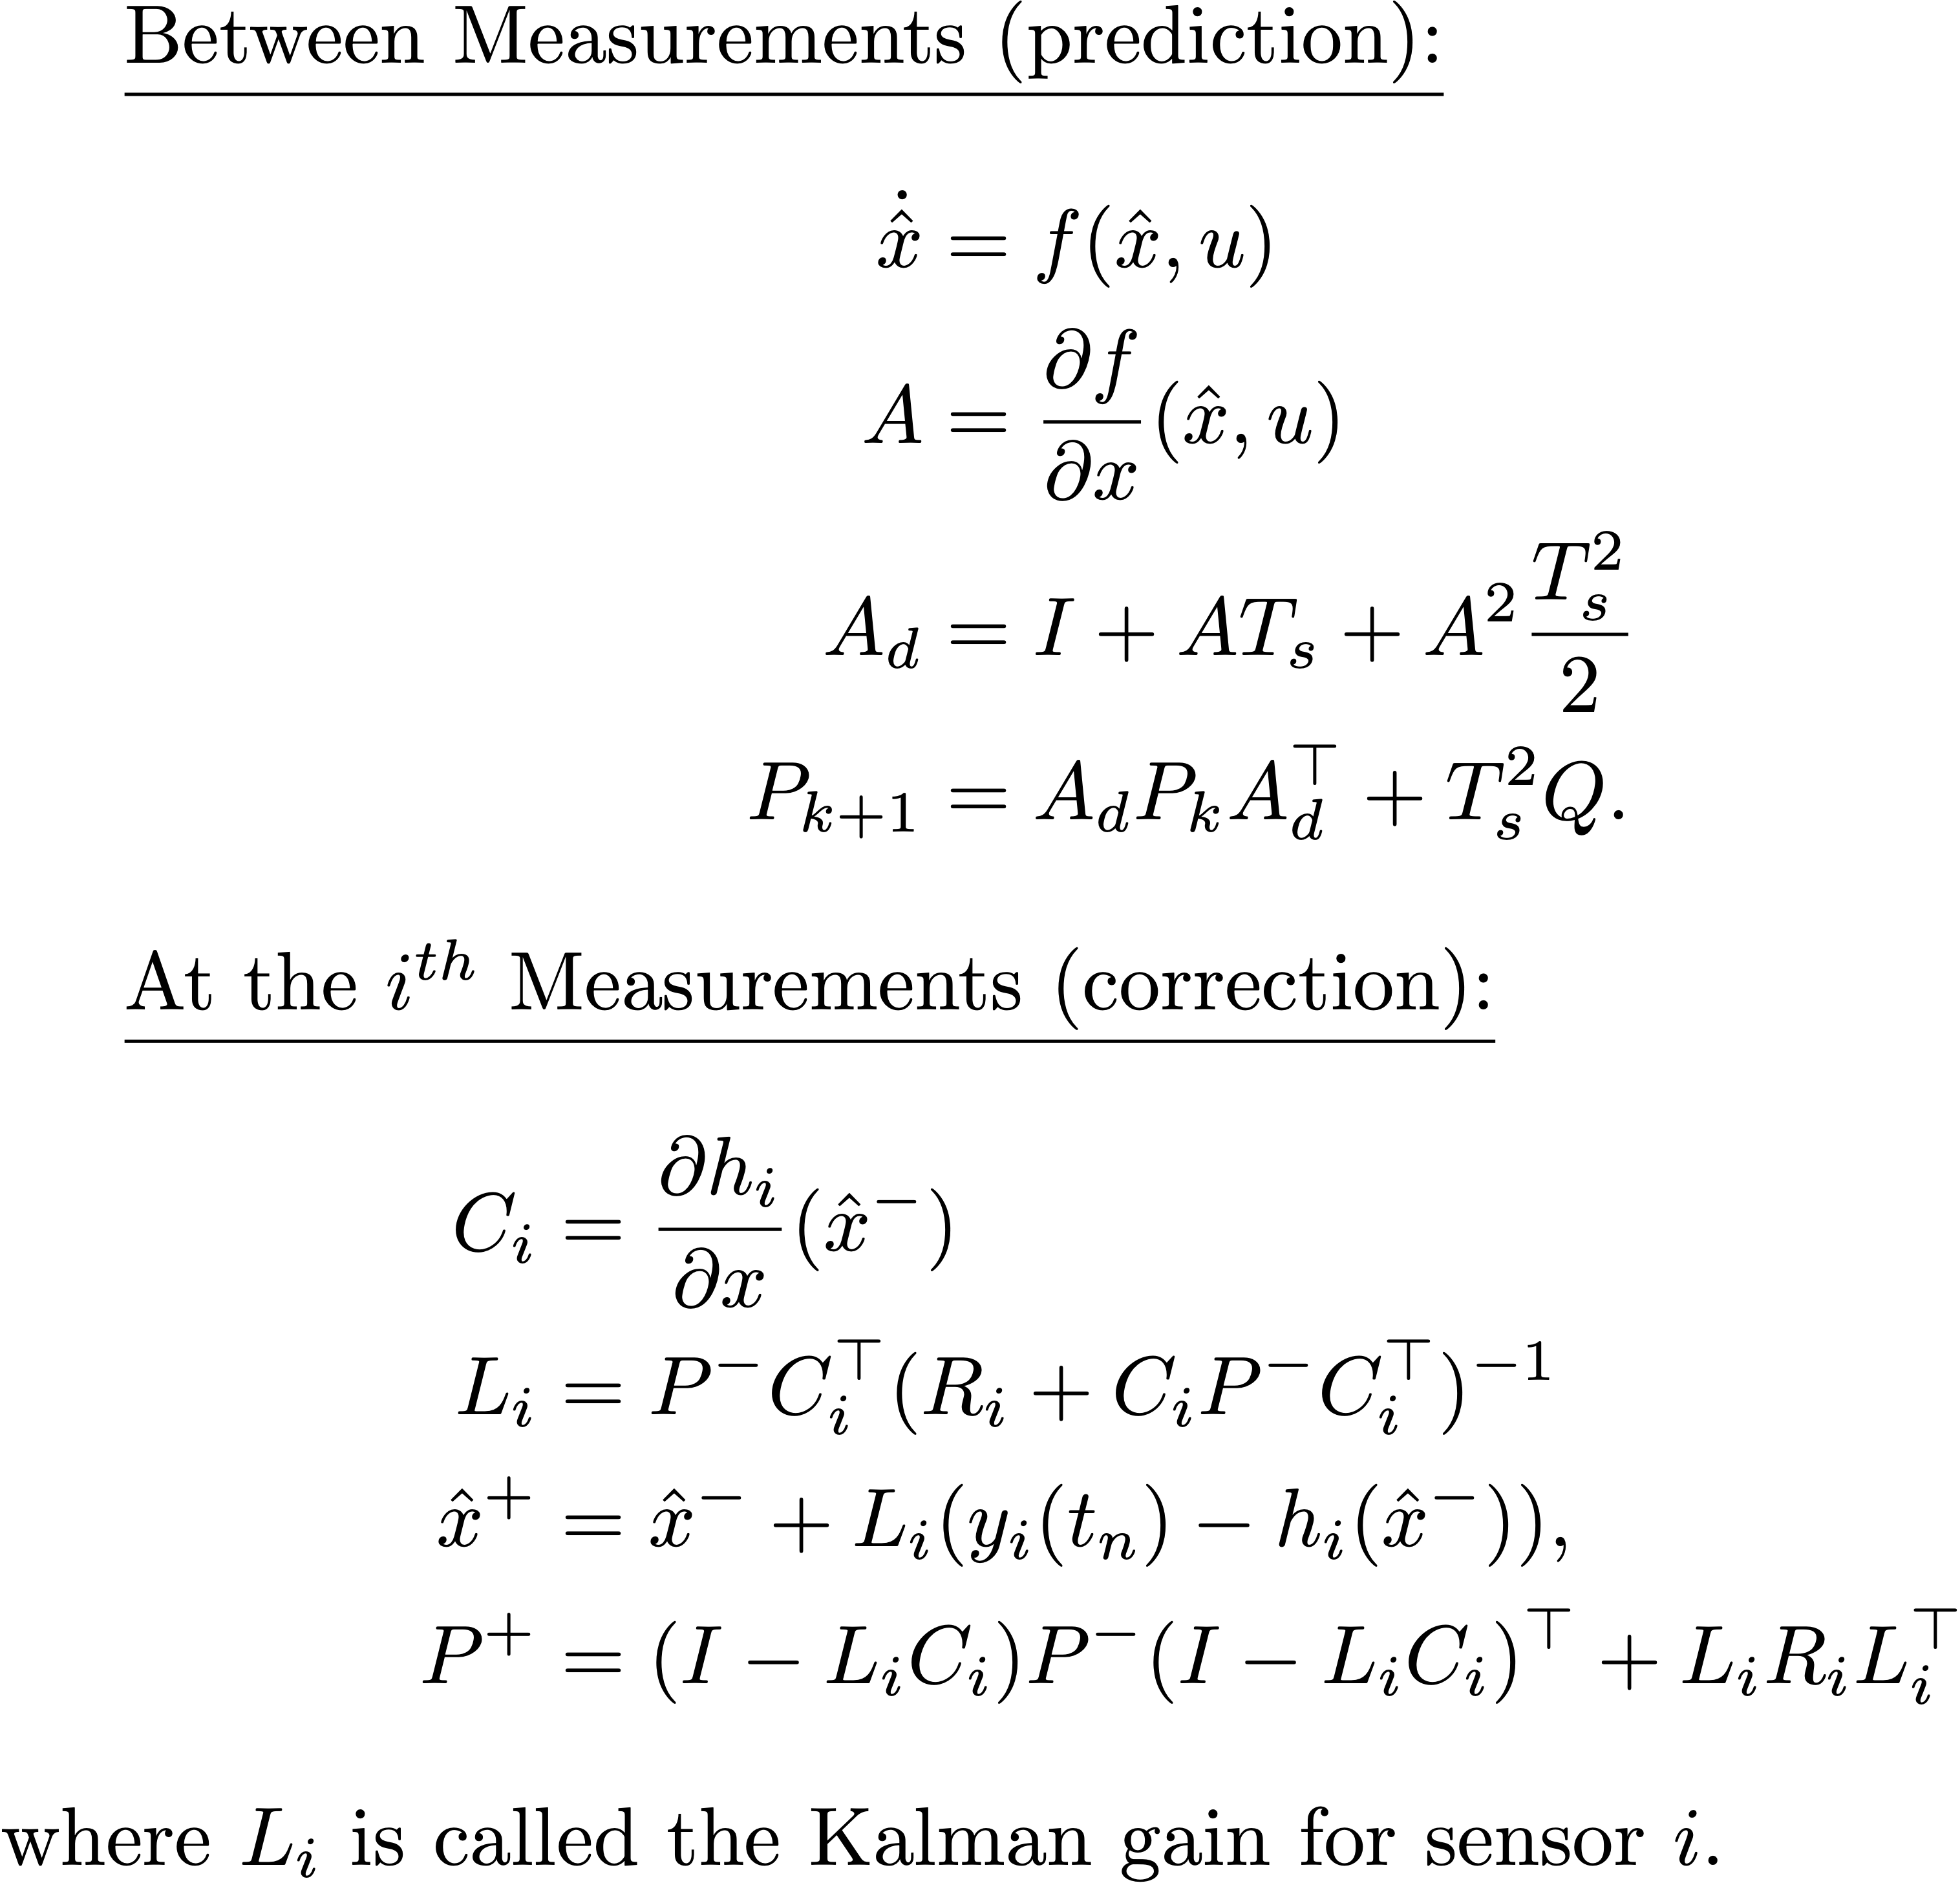
Extended Kalman Filter, cont.
Notes:
\underline{Between Measurements (prediction):}
\begin{align*}
\dot{\hat{x}} &= f(\hat{x}, u) \\
A &= \frac{\partial f}{\partial x}(\hat{x},u) \\
\dot{P} &= AP + PA^{\top} + Q,
\end{align*}
\underline{At the $i^{th}$ Measurements (correction):}
\begin{align*}
C_i &= \frac{\partial h_i}{\partial x}(\hat{x}^-) \\
L_i &= P^{-}C_i^{\top}(R_i+C_iP^{-}C_i^{\top})^{-1} \\
\hat{x}^+ &= \hat{x}^- + L_i(y_i(t_n) - h_i(\hat{x}^-)), \\
P^{+} &= (I-L_i C_i) P^{-} (I-L_i C_i)^\top + L_i R_i L_i^{\top}
\end{align*}
where $L_i$ is called the Kalman gain for sensor $i$.

Slide 31
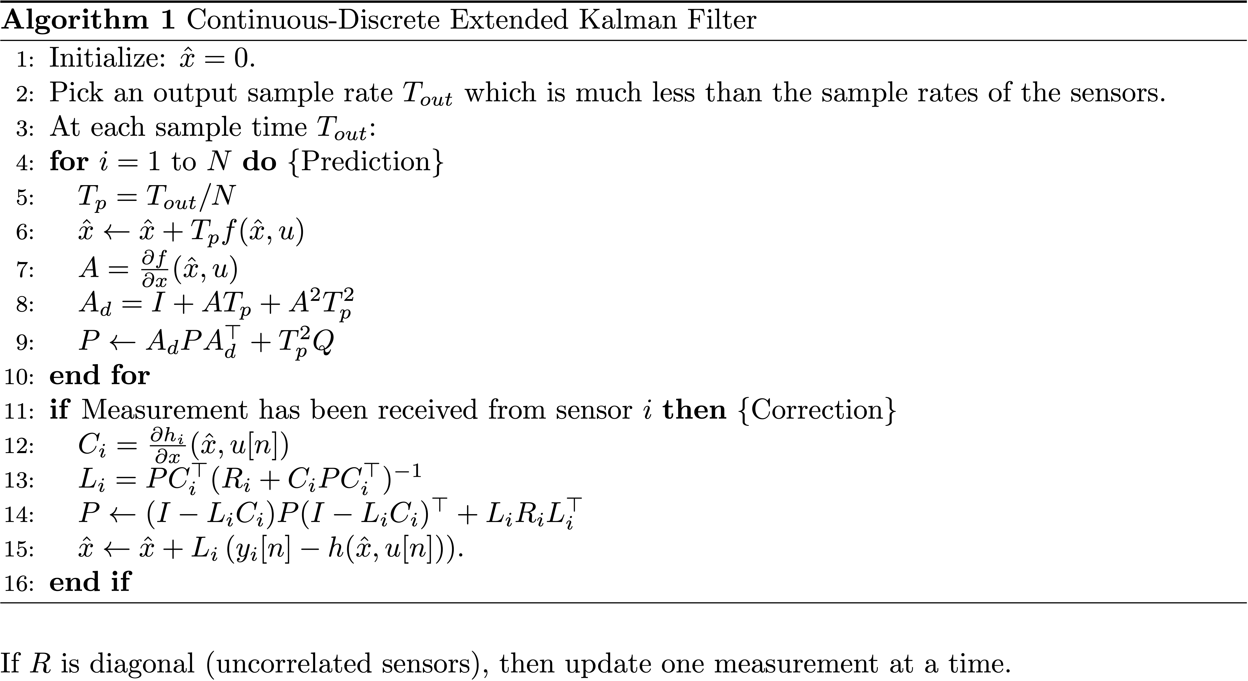
EKF Algorithm
Notes:
\begin{algorithm}
\caption{Continuous-Discrete Extended Kalman Filter}
\label{alg:est-kalman-continuous-discrete}
\begin{algorithmic}[1]
\STATE Initialize: $\hat{x} = 0$.
\STATE Pick an output sample rate $T_{out}$ which is much less than
the sample rates of the sensors.
\STATE At each sample time $T_{out}$:
\FOR[Prediction]{$i=1$ to $N$}
\STATE $T_p = T_{out}/N$
\STATE $\hat{x} \leftarrow \hat{x} + T_p f(\hat{x},u)$
\STATE $A = \frac{\partial f}{\partial x}(\hat{x},u)$
\STATE $A_d = I + A T_p + A^2 T_p^2$
\STATE $P \leftarrow A_d P A_d^\top + T_p^2 Q$
\ENDFOR
\IF[Correction]{Measurement has been received from
sensor $i$}
\STATE $C_i = \frac{\partial h_i}{\partial x}(\hat{x},u[n])$
\STATE $L_i = PC_i^{\top}(R_i+C_iPC_i^{\top})^{-1}$
\STATE $P \leftarrow (I-L_i C_i) P (I-L_i C_i)^\top + L_i R_i L_i^{\top}$
\STATE $\hat{x} \leftarrow \hat{x} + L_i\left( y_i[n] - h(\hat{x},u[n]) \right)$.
\ENDIF
\end{algorithmic}
\end{algorithm}
\noindent If $R$ is diagonal (uncorrelated sensors), then update one measurement at a time.

Slide 32
Attitude Estimation Using EKF
Notes:
\noindent
Use the nonlinear propagation model
\begin{align*}
\dot{\phi} &= p + q\sin\phi\tan\theta + r\cos\phi\tan\theta +
\xi_{\phi} \\
\dot{\theta} &= q\cos\phi - r\sin\phi +\xi_{\theta}
\end{align*}
where
\[
\xi_{\phi}\sim\mathcal{N}(0,Q_{\phi}) \qquad \text{~and~} \qquad
\xi_{\theta}\sim\mathcal{N}(0,Q_{\theta})
\]
Use accelerometers as measured outputs:
\begin{equation*}
y_{\text{accel}} =
\begin{pmatrix}
\dot{u} + qw - rv + g\sin\theta \\
\dot{v}+ru-pw - g\cos\theta\sin\phi \\
\dot{w}+pv-qu - g\cos\theta\cos\phi
\end{pmatrix}
+ \eta_{\text{accel}}.
\end{equation*}
\vspace{.5cm}
\noindent
Problem: Do not have method for directly measuring $\dot{u}$,
$\dot{v}$, $\dot{w}$, $u$, $v$, and $w$.
\vspace{.5cm}
\noindent
What do we do?

Slide 33
Attitude Estimation Using EKF
Notes:
\noindent Assume that $\dot{u}=\dot{v}=\dot{w}\approx 0$
\noindent Recall that
\[
\begin{pmatrix} u \\ v \\ w \end{pmatrix} \approx V_a
\begin{pmatrix} \cos\alpha\cos\beta \\ \sin\beta \\
\sin\alpha\cos\beta \end{pmatrix}.
\]
Assuming that $\alpha\approx\theta$ and $\beta\approx 0$ gives
\[
\begin{pmatrix} u \\ v \\ w \end{pmatrix} \approx V_a
\begin{pmatrix} \cos\theta \\ 0 \\
\sin\theta \end{pmatrix}
\]
Substituting into original output equation
\begin{equation*}
y_{\text{accel}} =
\begin{pmatrix}
\dot{u} + qw - rv + g\sin\theta \\
\dot{v}+ru-pw - g\cos\theta\sin\phi \\
\dot{w}+pv-qu - g\cos\theta\cos\phi
\end{pmatrix}
+ \eta_{\text{accel}}
\end{equation*}
gives
\[
y_{\text{accel}} =
\begin{pmatrix}
qV_a\sin\theta + g\sin\theta \\
rV_a\cos\theta - pV_a\sin\theta - g\cos\theta\sin\phi \\
-qV_a\cos\theta - g\cos\theta\cos\phi
\end{pmatrix}
+ \eta_{\text{accel}}
\]

Slide 34
Attitude Estimation Using EKF
Notes:
\noindent
Defining $x = (\phi, \theta)^{\top}$, $u=(p,q,r,V_a)^{\top}$, $\xi =
(\xi_{\phi}, \xi_{\theta})^{\top}$, and $\eta = (\eta_{\phi},
\eta_{\theta})^{\top}$, gives
\begin{align*}
\dot{x} &= f(x,u) + \xi \\
y &= h(x,u) + \eta,
\end{align*}
where
\begin{align*}
f(x,u) &= \begin{pmatrix}
p + q\sin\phi\tan\theta + r\cos\phi\tan\theta\\
q\cos\phi - r\sin\phi
\end{pmatrix} \\
h(x,u) &=
\begin{pmatrix}
qV_a\sin\theta + g\sin\theta \\
rV_a\cos\theta - pV_a\sin\theta - g\cos\theta\sin\phi \\
-qV_a\cos\theta - g\cos\theta\cos\phi
\end{pmatrix}
\end{align*}

Slide 35
Attitude Estimation Using EKF
Notes:
\noindent
Implementation of Kalman filter requires Jacobians
$\pde{f}{x}$ and $\pde{h}{x}$. \\ Accordingly,
\begin{align*}
\pde{f}{x} &=
\begin{pmatrix}
q\cos\phi\tan\theta - r\sin\phi\tan\theta &
\frac{q\sin\phi-r\cos\phi}{\cos^2\theta} \\
-q\sin\phi - r\cos\phi &
0
\end{pmatrix} \\
\pde{h}{x} &=
\begin{pmatrix}
0 &
qV_a\cos\theta + g\cos\theta \\
-g\cos\phi\cos\theta &
-rV_a\sin\theta -
pV_a\cos\theta + g\sin\phi\sin\theta \\
g\sin\phi\cos\theta &
\left(qV_a + g\cos\phi\right)\sin\theta
\end{pmatrix}.
\end{align*}
\vspace{.5cm}
\noindent
At this point, we have everything we need to implement the continuous-discrete EKF.
\vspace{.5cm}
\noindent
How well does it work?

Slide 36
Attitude Estimation Results
Not perfect, but significantly better!

Slide 37
GPS Smoothing
Notes:
\begin{itemize}
\item Want to fill in estimates between GPS measurements
\item Want to estimate wind
\end{itemize}
\noindent
Assuming level flight, evolution of position:
\begin{align*}
\dot{p}_n &= V_g\cos\chi \\
\dot{p}_e &= V_g\sin\chi
\end{align*}
\noindent
Evolution of the ground speed:
\begin{align*}
\dot{V}_g &= \frac{d}{dt} \sqrt{(V_a\cos\psi+w_n)^2 + (V_a\sin\psi+w_e)^2} \\
&= \frac{(V_a\cos\psi+w_n)(\dot{V}_a\cos\psi-V_a\dot{\psi}\sin\psi+\dot{w}_n)+(V_a\sin\psi+w_e)(\dot{V}_a\sin\psi+V_a\dot{\psi}\cos\psi+\dot{w}_e)}{V_g}
\end{align*}
Assuming that wind and airspeed are constant:
\[
\dot{V}_g = \frac{(V_a\cos\psi+w_n)(-V_a\dot{\psi}\sin\psi)+(V_a\sin\psi+w_e)(V_a\dot{\psi}\cos\psi)}{V_g}
\]

Slide 38
GPS Smoothing

Slide 39
GPS Smoothing
Notes:
\noindent
Evolution of $\chi$:
\[
\dot{\chi}=\frac{g}{V_g}\tan\phi\cos(\chi-\psi)
\]
\noindent
Assuming that wind is constant:
\begin{align*}
\dot{w}_n &= 0 \\
\dot{w}_e &= 0
\end{align*}
\noindent
From kinematics, evolution of $\psi$:
\begin{equation*}
\dot{\psi} = q\frac{\sin\phi}{\cos\theta} + r\frac{\cos\phi}{\cos\theta}
\end{equation*}

Slide 40
GPS Smoothing
Notes:
\noindent
Define: \\
$x=(p_n,p_e,V_g,\chi,w_n,w_e,\psi)^{\top}$ \\
$u=(V_a, q, r, \phi, \theta)^{\top}$ \\
\\
Jacobian of $f$:
\[
\pde{f}{x} =
\begin{pmatrix}
0 & 0 & \cos\chi & -V_g\sin\chi & 0 & 0 & 0 \\
0 & 0 & \sin\chi & V_g\cos\chi & 0 & 0 & 0 \\
0 & 0 & -\frac{\dot{V}_g}{V_g} & 0 & -\dot{\psi}V_a\sin\psi & \dot{\psi}V_a\cos\psi & \frac{\partial \dot{V}_g}{\partial \psi} \\
0 & 0 & \frac{\partial \dot{\chi}}{\partial V_g} & \frac{\partial \dot{\chi}}{\partial \chi} & 0 & 0 & \frac{\partial \dot{\chi}}{\partial \psi} \\
0 & 0 & 0 & 0 & 0 & 0 & 0 \\
0 & 0 & 0 & 0 & 0 & 0 & 0 \\
0 & 0 & 0 & 0 & 0 & 0 & 0
\end{pmatrix}
\]
where
\begin{align*}
\frac{\partial \dot{V}_g}{\partial \psi} &= \frac{-\dot{\psi}V_a(w_n\cos\psi+w_e\sin\psi)}{V_g} \\
\frac{\partial \dot{\chi}}{\partial V_g} &= -\frac{g}{V_g^2}\tan\phi\cos(\chi-\psi) \\
\frac{\partial \dot{\chi}}{\partial \chi} &= -\frac{g}{V_g}\tan\phi\sin(\chi-\psi) \\
\frac{\partial \dot{\chi}}{\partial \psi} &= \frac{g}{V_g}\tan\phi\sin(\chi-\psi) \\
\end{align*}

Slide 41
GPS Smoothing
Notes:
\noindent
Define: \\
$x=(p_n,p_e,V_g,\chi,w_n,w_e,\psi)^{\top}$ \\
$u=(V_a, q, r, \phi, \theta)^{\top}$ \\
\\
For measurements, use GPS signals for north and east position $(p_n,p_e)$, ground speed $(V_g)$, and course $(\chi)$
\vspace{.5cm}
\noindent
Notice that states are not independent -- related by wind triangle
\vspace{.5cm}
\noindent
Use wind triangle relations to introduce two pseudo measurements. \\
\\
Assume $\gamma=\gamma_a=0$:
\begin{align*}
V_a\cos\psi + w_n &= V_g\cos\chi \\
V_a\sin\psi + w_e &= V_g\sin\chi
\end{align*}
\noindent
From these expressions, define the pseudo measurements
\begin{align*}
y_{\text{windtri,n}} &= V_a\cos\psi + w_n - V_g\cos\chi \\
y_{\text{windtri,e}} &= V_a\sin\psi + w_e - V_g\sin\chi
\end{align*}
where (pseudo) measurement values are equal to zero.

Slide 42
GPS Smoothing
Notes:
\noindent
The resulting measurement model is given by
\[
y_{GPS} = h(x,u) + \eta_{GPS}
\]
where $y_{GPS} = (y_{GPS,n}, y_{GPS,e}, y_{GPS,V_g}, y_{GPS,\chi}, y_{\text{wind,n}}, y_{\text{wind,e}})$, and
\[
h(x,u) = \begin{pmatrix}
p_n \\
p_e \\
V_g \\
\chi \\
V_a\cos\psi + w_n - V_g\cos\chi \\
V_a\sin\psi + w_e - V_g\sin\chi
\end{pmatrix}
\]
and where the Jacobian is given by
\[
\pde{h}{x}(\hat{x},u) =
\begin{pmatrix}
1 & 0 & 0 & 0 & 0 & 0 & 0 \\
0 & 1 & 0 & 0 & 0 & 0 & 0 \\
0 & 0 & 1 & 0 & 0 & 0 & 0 \\
0 & 0 & 0 & 1 & 0 & 0 & 0 \\
0 & 0 & -\cos\chi & V_g\sin\chi & 1 & 0 & -V_a\sin\psi \\
0 & 0 & -\sin\chi & -V_g\cos\chi & 0 & 1 & V_a\cos\psi
\end{pmatrix}
\]

Slide 43
GPS Smoothing Results

Slide 44
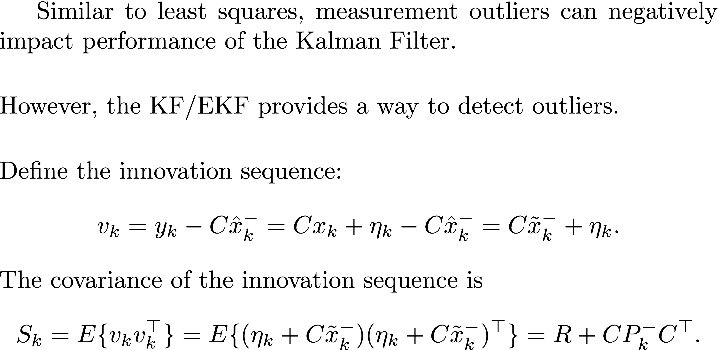
Measurement Gating
Notes:
Similar to least squares, measurement outliers can negatively impact performance of the Kalman Filter.
\vspace{0.5cm}
\noindent However, the KF/EKF provides a way to detect outliers.
\vspace{0.5cm}
\noindent Define the innovation sequence:
\begin{align*}
v_k = y_k - C \hat{x}_k^- = C x_k + \eta_k - C\hat{x}_k^- = C\tilde{x}_k^- + \eta_k.
\end{align*}
The covariance of the innovation sequence is
\begin{align*}
S_k &= E\{ v_k v_k^\top \} = E\{ (\eta_k + C\tilde{x}_k^-)(\eta_k + C\tilde{x}_k^-)^\top \} = R + C P_k^- C^\top.
\end{align*}

Slide 45
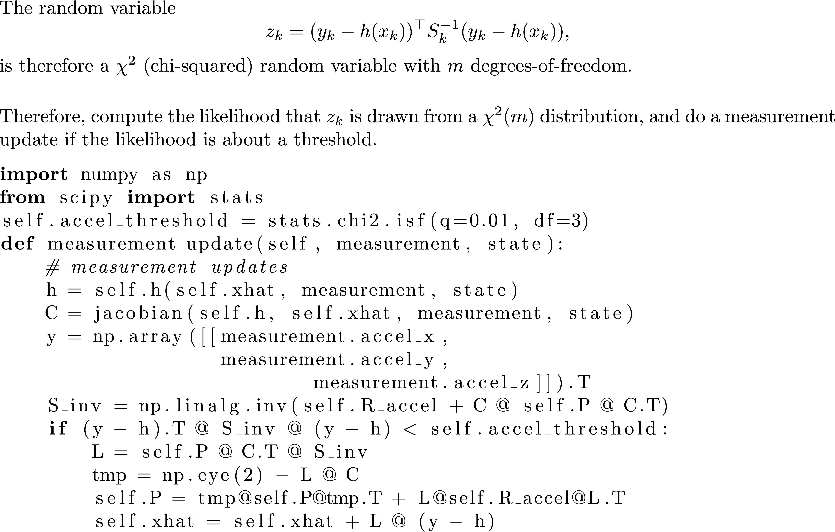
Measurement Gating
Notes:
Similar to least squares, measurement outliers can negatively impact performance of the Kalman Filter.
\vspace{0.5cm}
\noindent However, the KF/EKF provides a way to detect outliers.
\vspace{0.5cm}
\noindent Define the innovation sequence:
\begin{align*}
v_k = y_k - C \hat{x}_k^- = C x_k + \eta_k - C\hat{x}_k^- = C\tilde{x}_k^- + \eta_k.
\end{align*}
The covariance of the innovation sequence is
\begin{align*}
S_k &= E\{ v_k v_k^\top \} = E\{ (\eta_k + C\tilde{x}_k^-)(\eta_k + C\tilde{x}_k^-)^\top \} = R + C P_k^- C^\top.
\end{align*}

Slide 46
Suggestions for Tuning Your EKF
Implement EKF in steps
Attitude estimation
GPS smoother
Test and tune each component independently and thoroughly
Attitude estimator first
GPS smoother second
As a first step, make sure your filter estimates track the states when sensors are perfect (no sensor error). This will expose coding errors and show the limits of performance of your filter.
Keep the wind set to zero until you are confident that your filter is well tuned.
We know R pretty well typically. Tune filter by changing Q.
Tune filter by focusing on individual states. Give inputs to those states while keeping other states “quiet”. Adjust Q value corresponding to state of interest. Tune by trial and error (use your brain to make a good guess!).
Don’t put extreme inputs into the system when tuning the filter (e.g., large steps). Your filter will have its own dynamic limits – don’t make the problem impossibly difficult.
Tune your controllers so that the response of the aircraft to typical inputs is smooth and graceful. Abrupt and jerky state dynamics are difficult to estimate.
Check your equations AGAIN!

